Slide 1
Clickjacking Attack Lab

Slide 2
Clickjacking Attack Lab
In this lab students will see an example of how a clickjacking attack works.
Materials needed
Kali Linux Machine
Windows 7 Machine
Software Tools used
Burp Suite (Web Application Analysis Tool)

Slide 3
Objectives Covered
Security+ Objectives (SY0-501)
Objective 1.2 - Compare and contrast types of attacks
Application/Service Attacks
Hijacking and related attacks
Clickjacking

Slide 4

What is a Clickjacking attack?
Tricking a user into clicking a link that seems harmless
This click can be malicious in many ways
Can download a virus
Can ask the user to input private information
Can send the user to a malicious website
Can have the user pay money to someone
Would you trust clicking “Google Search” in the image?
How do you know this button is safe?
What if someone has an invisible button on top of it?
Would you click this?

Slide 5
The Clickjacking Attack Lab
Copy Clickbandit JavaScript
Set-up the Clickjacking webpage
Save the Clickjacking webpage
Testing the Clickjacking webpage
Hide the Clickjacking Box
Re-test the Webpage

Slide 6

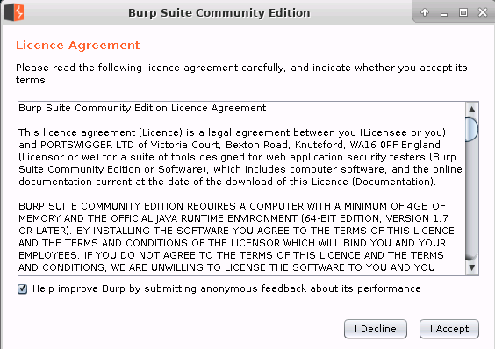
Copy Clickbandit JavaScript
Open the Kali Linux Environment
Open a Terminal
Open the Burp Suite application
burpsuite
You should see a license agreement open
Click “I Accept” on the License Agreement
This will start Burp Suite!

Slide 7
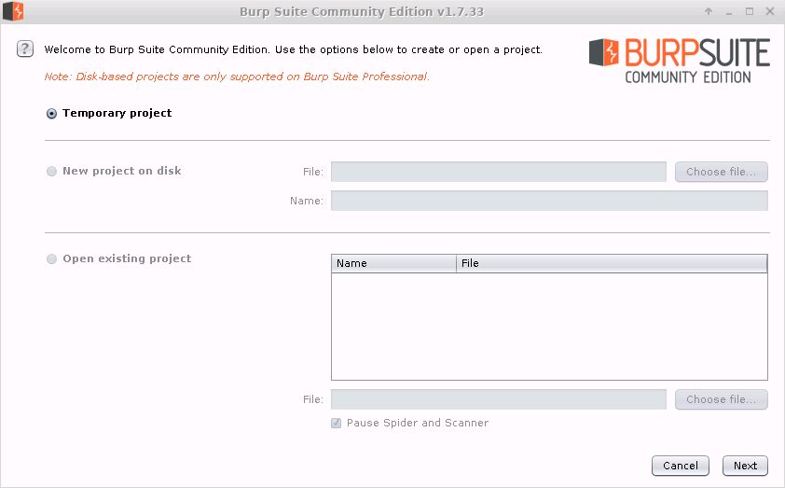
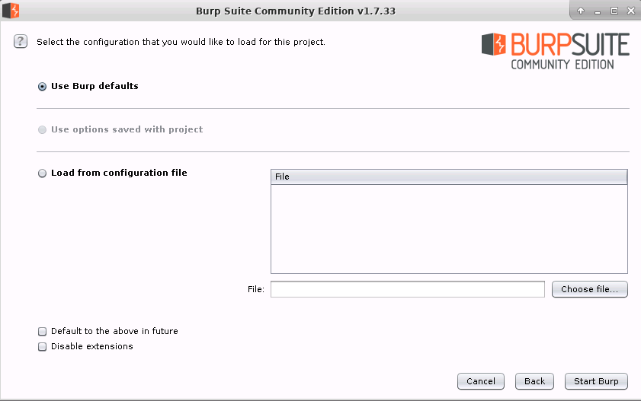
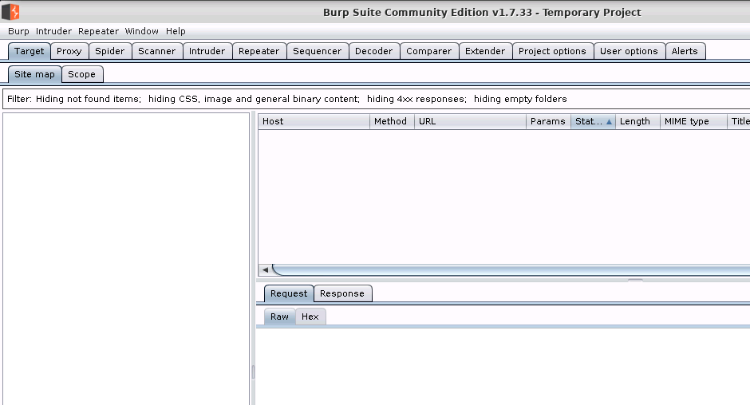
Copy Clickbandit JavaScript
Select “temporary project”
Then select “next”
Select “Use Burn defaults”
Then select “Start Burp”
This will launch the Burp Suite application
Burp Suite

Slide 8
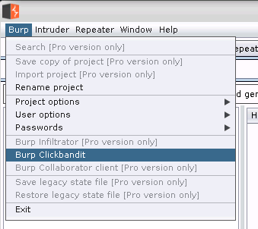
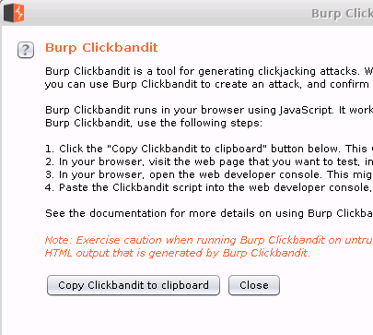
Copy Clickbandit JavaScript
Select the “Burp” menu
Then select Burp “Clickbandit”
This will open Clickbandit prompt
Read over the 4-step instructions
What is it telling you?
You are going to follow these steps
Select the “Copy Clickbait to clipboard”
This copies the Clickbandit JavaScript to the clipboard so we can paste it into a website
You can exit out of Burp Suite

Slide 9
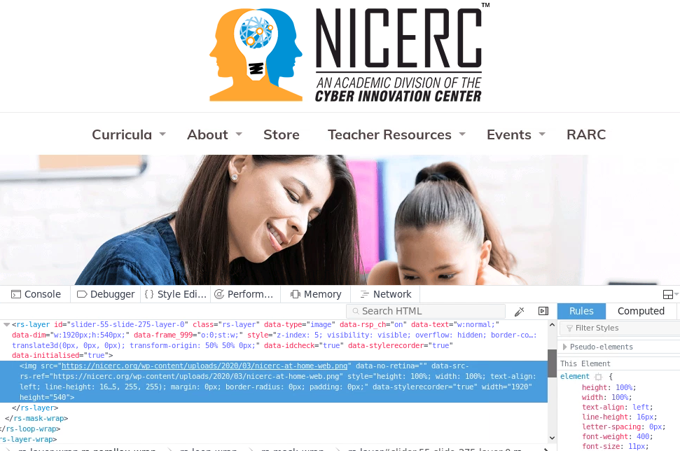
Set-up the Clickjacking Webpage
Open the web browser
Go to the URL you want to pose as
For example www.nicerc.org
In the webpage, right-click
Select “Inspect”
May be “inspect element”
This opens the webpage files
Webpage Data

Slide 10

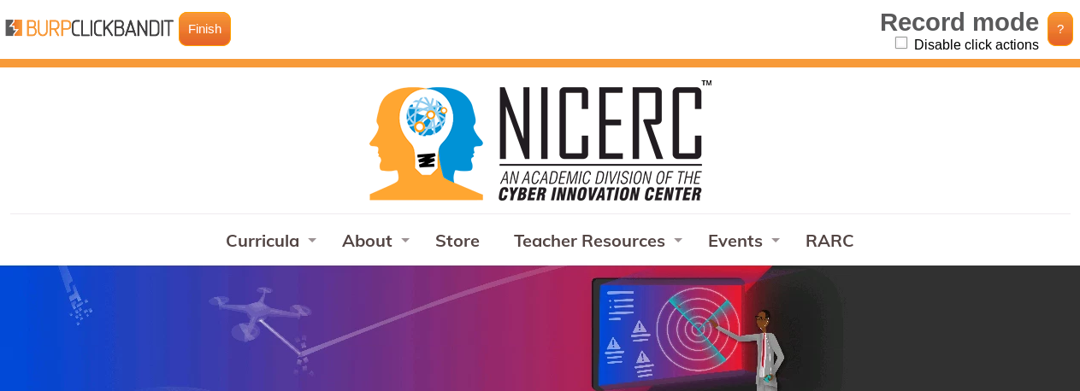
Set-up the Clickjacking Webpage
Click on the “console” tab
Type in “allow pasting”
Hit <ENTER> twice (to run)
Paste in the Clickbandit JavaScript
Hit <ENTER> to run the JavaScript
Exit out of the Inspect console
You should see the webpage loaded with a BURPCLICKBAIT banner at the top
BURPCLICKBANDIT Banner

Slide 11

Save the Clickjacking Webpage
Select the “Disable click actions” option
Select the image on the webpage you think the user will click
Then, select “Finish”
You should see the webpage with a red box over the image that you clicked.
Select Save to save the HTML files
Should save to Downloads folder
Image that was selected

Slide 12
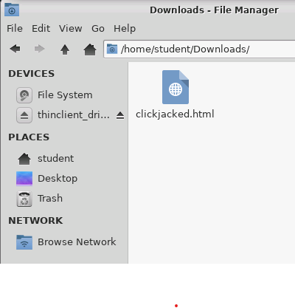

Testing the Clickjacking Webpage
Open to the Downloads folder
Open the clickjacked HTML page in a browser
Notice it opens the webpage
It also shows the click area
Click on the image
You should see that “You have been clickjacked!”
This is an example of a webpage that runs a script when you click on an unsuspicious image

Slide 13
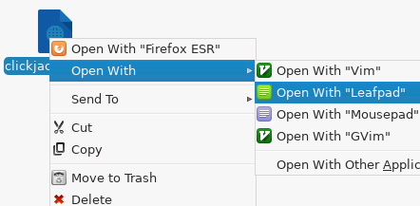
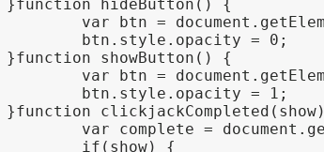
Hide the Clickjacking Box
A lot can be done to alter the webpage files to hide the clickjacking area
Go to the Downloads folder
Right-click and open the html files in a text editor (like Leafpad)
Find the “function showButton”
Change the “opacity = 1”
change to “opacity = 0”
This will hide the click button
Save and exit the text editor
Change to a “0”

Slide 14
Re-test the Clickjacking Webpage
Open the clickjacking webpage up in an web browser again
Do you see the clickjacking box?
You should not see the box
What happens when you click the image?
You should notice it tells you that you were clickjacked again
What else would you change about the webpage to make it look more appealing so that someone would click on the image?

Slide 15
How to Defend against Clickjacking Attacks?
Only visit trusted websites!
Why is it dangerous to visit websites that are not “trusted”?
Use a extension that prevents invisible or embedded objects
Prevents from allowing clickjacking items to be clicked on
An example is the “NoScript” application
How else can you defend against a clickjacking attack?

